Slide 1
Market Salary Analysis for a Data Scientist Hire
By Peter Jordan

Slide 2
Introduction to the Analysis
Purpose: Determine a fair, competitive salary for hiring a Data Scientist at a small, growing company
Focus: U.S. vs Offshore comparison
Method: Use IQR-based analysis to avoid outliers and get realistic salary ranges
Goal: Provide a clear recommendation aligned with market data and CEO requirements

Slide 3
Data Used & Filtering
Included:
Data Scientist (only this job title)
Small-company records
U.S. + Non-U.S. salaries
Why Only “Data Scientist”?
Matches the role the CEO intends to hire
Avoids skew from engineering/analyst/manager salaries
Gives a clean, accurate benchmark for a small company

Slide 4
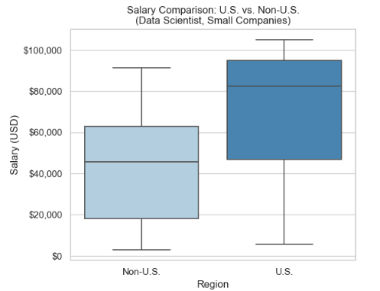
U.S. vs. Offshore Salaries (Data Scientist — Small Companies)
U.S. Data Scientist
IQR: $46.9K – $95K
Median: $82.5K
Takeaway: U.S. pay is almost 2× higher than offshore, reflecting a more competitive and mature market.
Offshore Data Scientist
IQR: $18.1K – $62.7K
Median: $45.7K
Takeaway: Offshore salaries vary widely; many regions offer very low-cost talent, but quality and consistency differ.

Slide 5
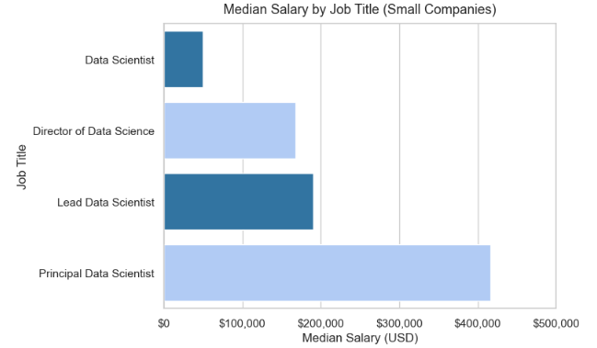
Recommended Job Title — “Data Scientist” (with growth path to Lead Data Scientist)
Why this role?
Matches the CEO’s need for one person to own modeling + analytics.
Ideal for a small, fast-growing company (broad skillset, hands-on).
Senior titles (Lead, Director, Principal) cost far more at small firms.
Provides a clear growth path as the company scales.
Salary Insights (Small Companies Only — U.S.)
Data Scientist: ~$50K–$100K typical U.S. range (varies by dataset/IQR).
Lead Data Scientist: ~$190K median (too expensive for small firm).
Director: ~$168K median.
Principal: ~$416K median (enterprise-level only).
Key Message
Hiring a Data Scientist gives the company strong capability now without the very high cost of senior leadership titles — while still leaving room for a future promotion to Lead Data Scientist.

Slide 6
Salary Range Recommendation (Based on IQR)
 | U.S. Data Scientist | Offshore Data Scientist
P25 | $88,125 | $16,904
Median | $95,000 | $45,760
P75 | $101,250 | $62,726
IQR Range | $88,125 –$101,250 | $16,904 –$62,726
U.S. Candidate (Preferred Hire)
Recommended Range: $90K – $105K
Aligned with the U.S. IQR ($88K – $101K)
Keeps the offer competitive without hitting outliers
Leaves room for growth into a Lead Data Scientist role
Offshore Candidate (Alternative Option)
Recommended Range: $45K – $60K
Based on the upper half of offshore IQR
Lower cost but wider salary variation and less stability
Why This Range Works
Uses IQR (not outliers) to reflect realistic market conditions
Balances cost efficiency with competitiveness
Leaves room for growth into a Lead Data Scientist role

Slide 7
Final Recommendation to CEO
U.S. Hire (Preferred)
Recommended Salary Range: $90K – $105K
Aligned with the U.S. IQR: $88K – $101K
Competitive without exceeding small-company norms
Supports hiring someone who can own analytics now and grow into Lead Data Scientist later
Offshore Hire (Alternative Option)
Recommended Salary Range: $45K – $60K
Based on the upper half of the offshore IQR: $45K – $63K
Cost-effective option, but offshore salaries vary widely
May introduce challenges with time zones, communication, and future leadership capability
Why This Works
Directly grounded in Data Scientist IQR data (no outliers, no inflated ranges)
Fits the compensation realities of a small but rapidly growing company
Competitive enough to attract strong U.S. candidates
Offshore option preserves cost efficiency if budget becomes a constraint
Leaves room for salary progression as the role evolves into Lead Data Scientist

